Slide 1
بسم الله الرحمن الرحيم

Slide 2
Topic (4)
Snails transmitted Trematodes

Slide 3
I.L.Os:
Role plaid by snails in trematodes infection.
Memorise the stage of parasite in snails.
Mode of infection of man by those parasites.
Control of snails.

Slide 4
Role plaid by snails in trematodes infection:
Intermediate host
Fasciola hepatica ______ Lymnaea spp.
Heterophyes heterophyes _______ Pirenella conica
Scistosoma mansoni ________ Biomphalaria alexandrina
Schistosoma hematobium _____ Bolinus trancatus

Slide 5
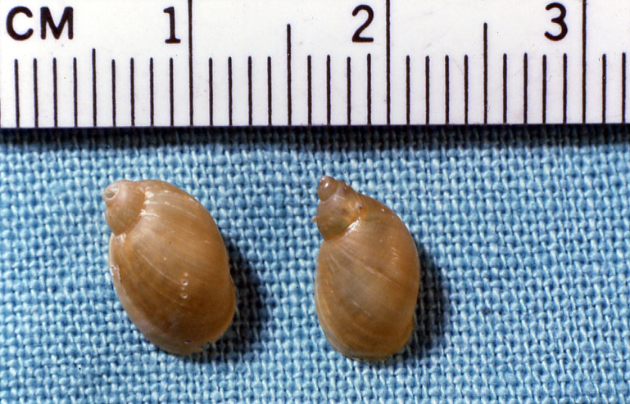

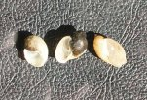
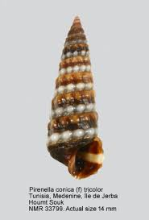
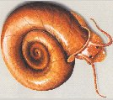
Bulinus truncatus
Lymnaea sp.
Biomphalaria alexandrina
Pirenella conica

Slide 6
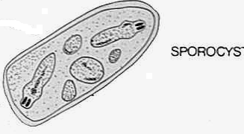
Memorise the stage of parasite in snails.
The miracidium ______________
Sporocyst (may be daughter also) ____________
Redia (may be daughter also) or not present as in Schistosoma spp.____________ then cercaria is shed out from the snail.

Slide 7
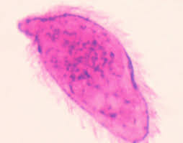
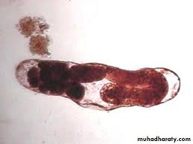
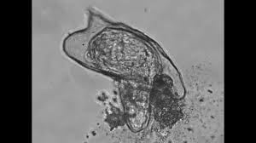
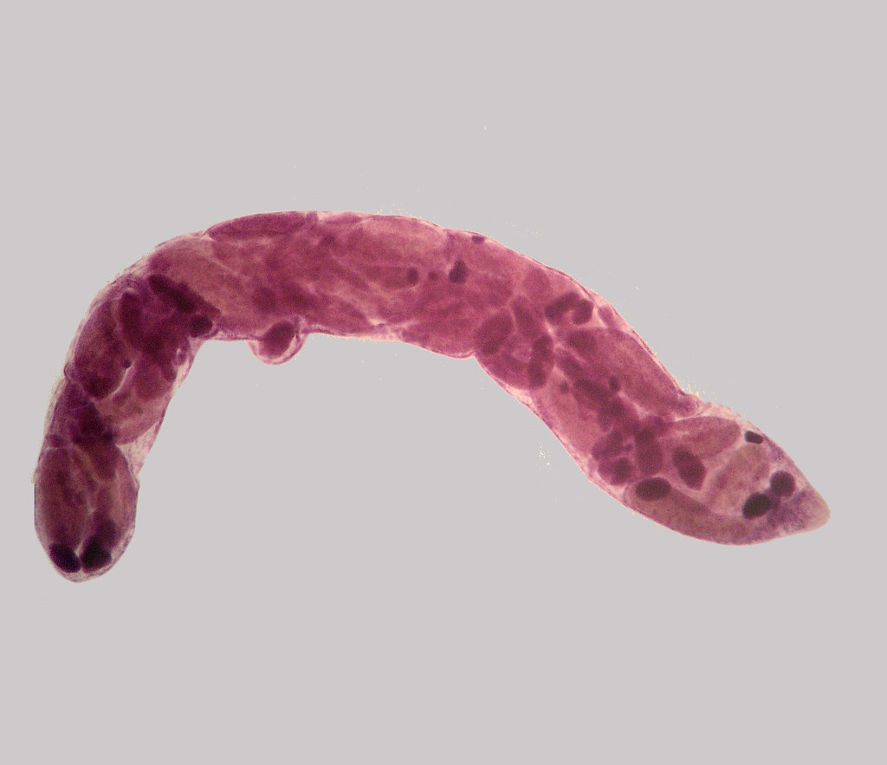
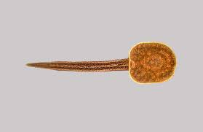

Slide 8
Mode of infection of man by those parasites
Fasciola hepatica ______ eating encysted metacercaria on green leaves or water
Heterophyes heterophyes _______eating encysted metacercaria in fish meat
Schistosoma mansoni ________ cercaria penetrating skin or mucus membranes
Schistosoma haematobium _____ cercaria penetrating skin or mucus membranes

Slide 9
Control of snails
1- by using molluscicides as copper sulphate or baylucide (but hard to be achieved as the snail population always returns to previous numbers and molluscicide- resistant populations emerge frequently}.
2- Biological control is done by using natural competitors or predators like ducks, fish, other snail species, and certain fungi.
3- Irrigation engineering, for smooth cemented slope-canals not to hold vegetations.

